Slide 1
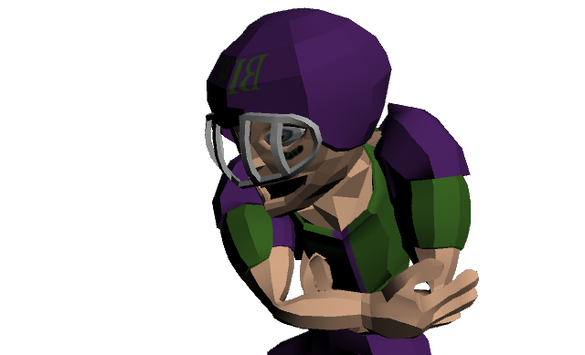

Nicholas Moore, Seth Konoza, Michael Murphy, & Harris Weinstein

Slide 2
A LONG TIME AGO, IN GAMES I…

Slide 3


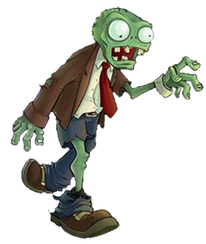
BROPOCALYPSE
REGULAR FIGHTER

Slide 4
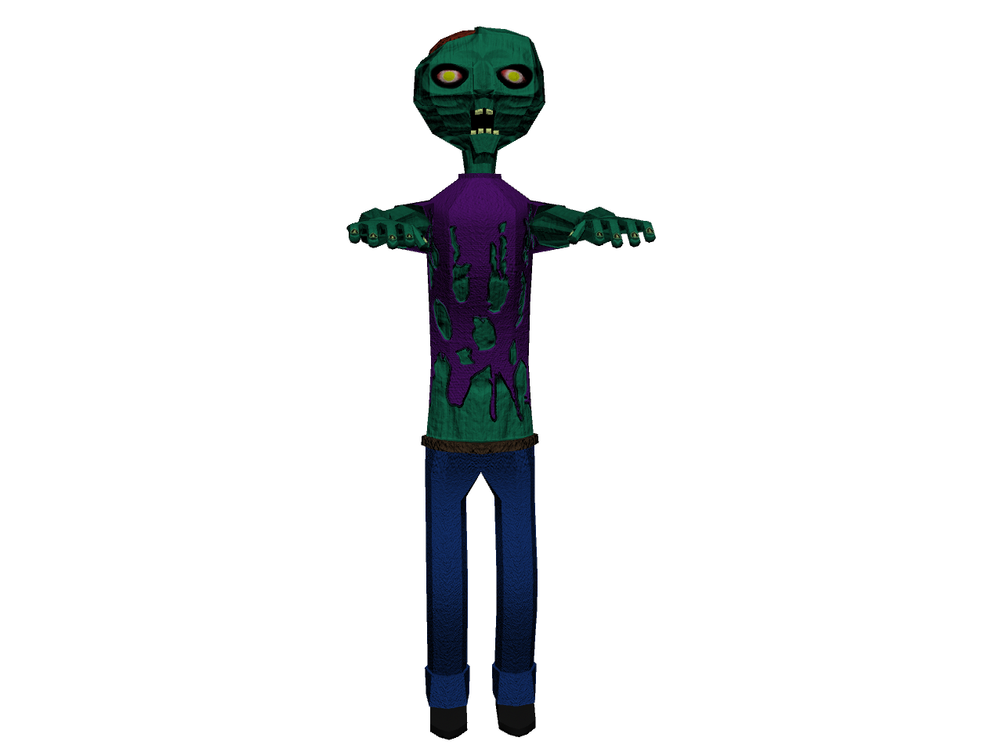
WINNER: BROPOCALYPSE!
BRAINS… (YAY)

Slide 5
Concept
Side-scroller beat-em-up game, in 16-bit arcade style of “The Simpsons Arcade Game” and “Retro City Rampage”
Characters in games bases off of various college varsity sports/fraternity stereotypes
Attacks are based off of these characteristics
Brostat: basic stats in game, affected by items/weapons in game
Can choose any bro character at the beginning of each level/checkpoint

Slide 6
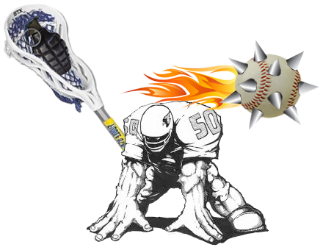
Character Examples
Laxbro: hurls projectiles with lacrosse stick
Footbro: higher health & defense but slower with pads, close combat
Basebro: Hurls ranged, accurate projectiles

Slide 7


Power Measurements
Alcohol bar: goes up when character picks up alcohol throughout levels
Strength increases up to a certain alcohol level
Strength decreases exponentially after that level
Bar empties over time not consuming alcohol
Stamina bar
Level decreases during character attacks
Regenerates over time not attacking

Slide 8

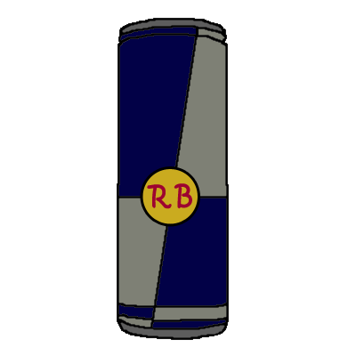
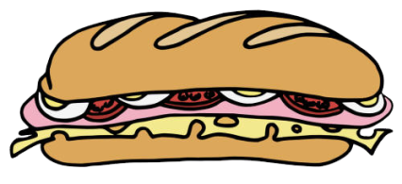
Power-Ups
Alcohol: increases alcohol bar level
Red bull
Increases strength & reduced alcohol bar level
Increases stamina bar, but this addition decreases over time until it is gone, even during non-attacking time
Fat sammich: increases health

Slide 9
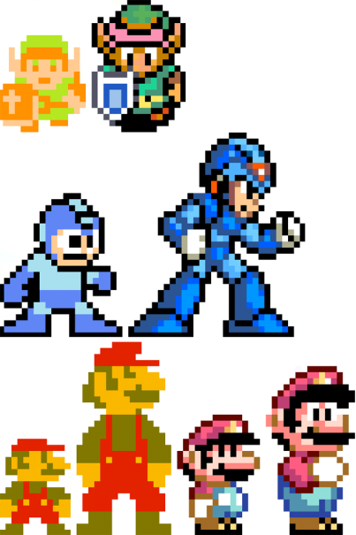
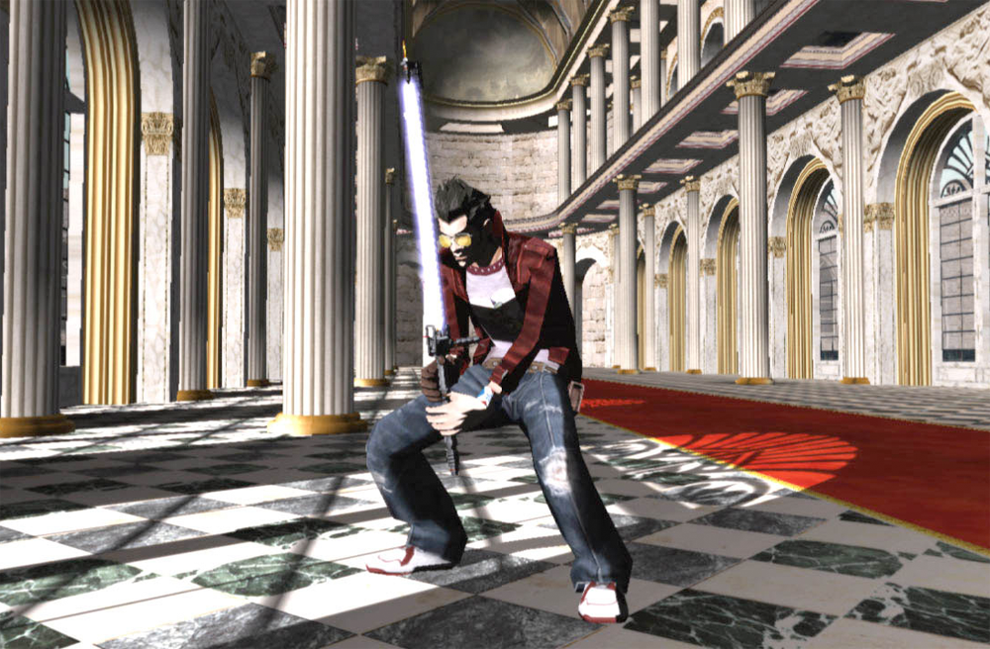
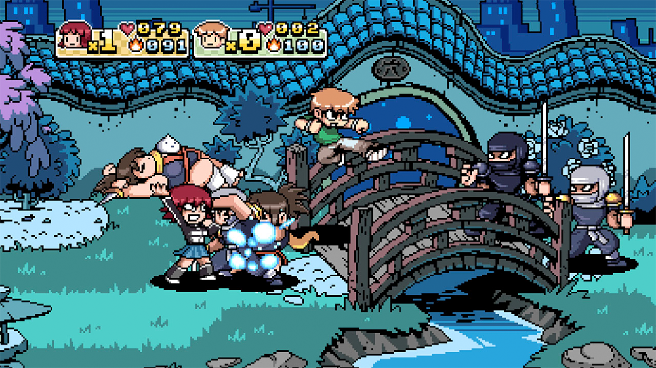
Initial Influences
8-bit/16-bit Variants
No More Heroes
Scott Pilgrim vs. The World ->

Slide 10
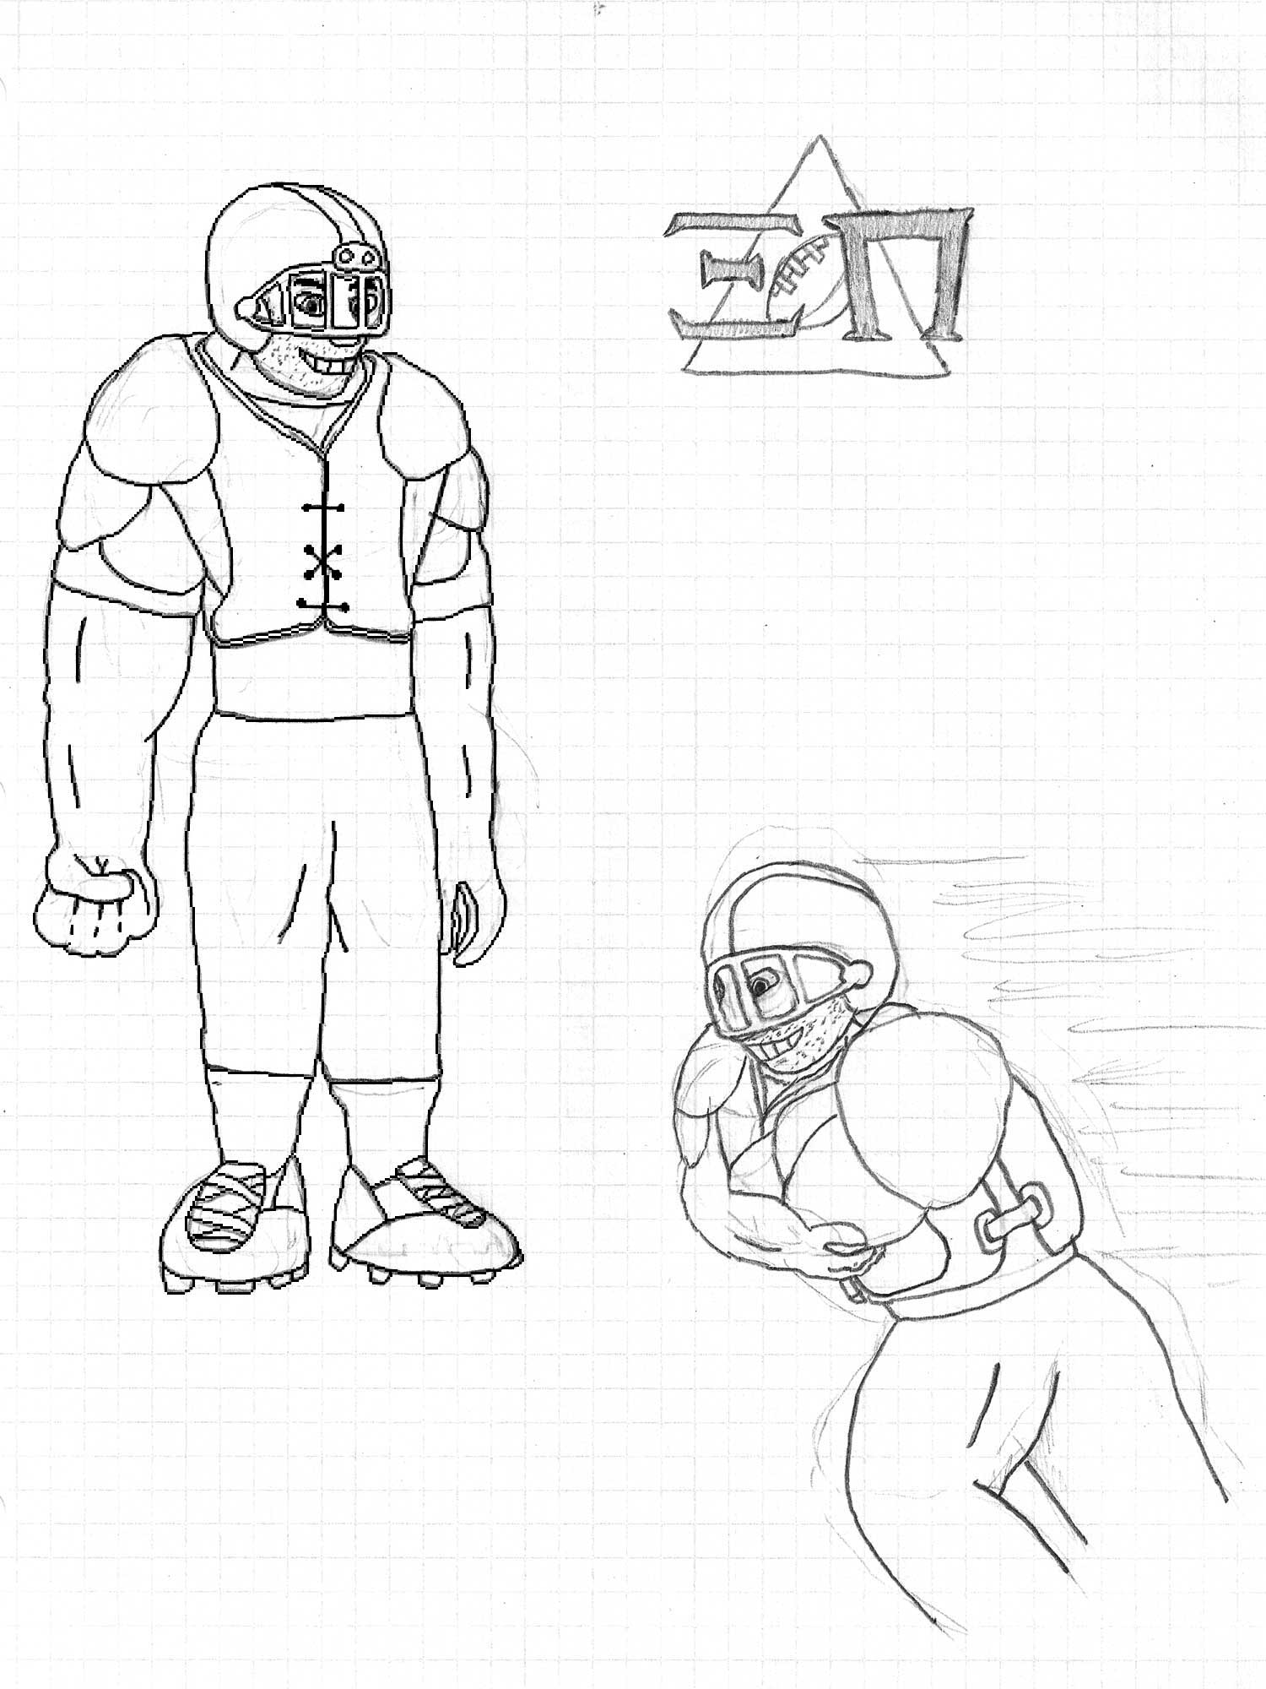

Slide 11
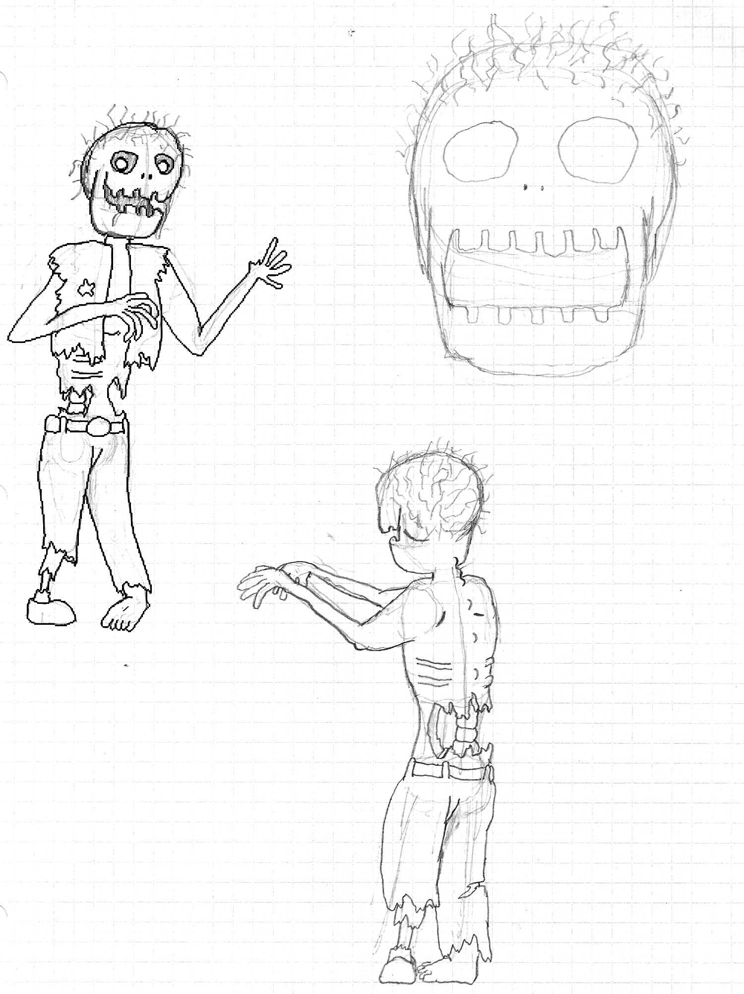

Slide 12
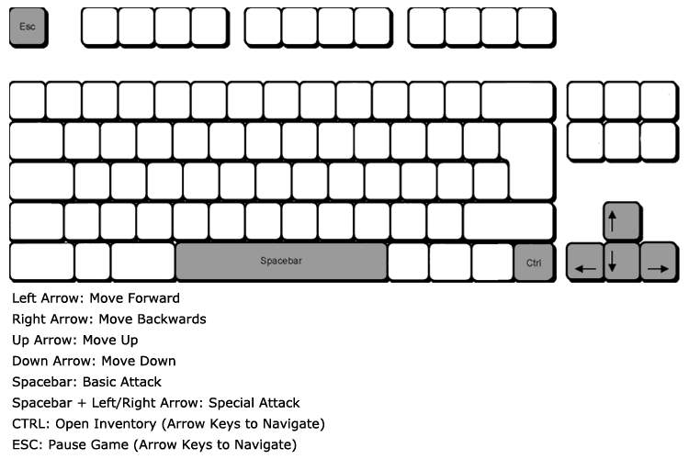

Slide 13
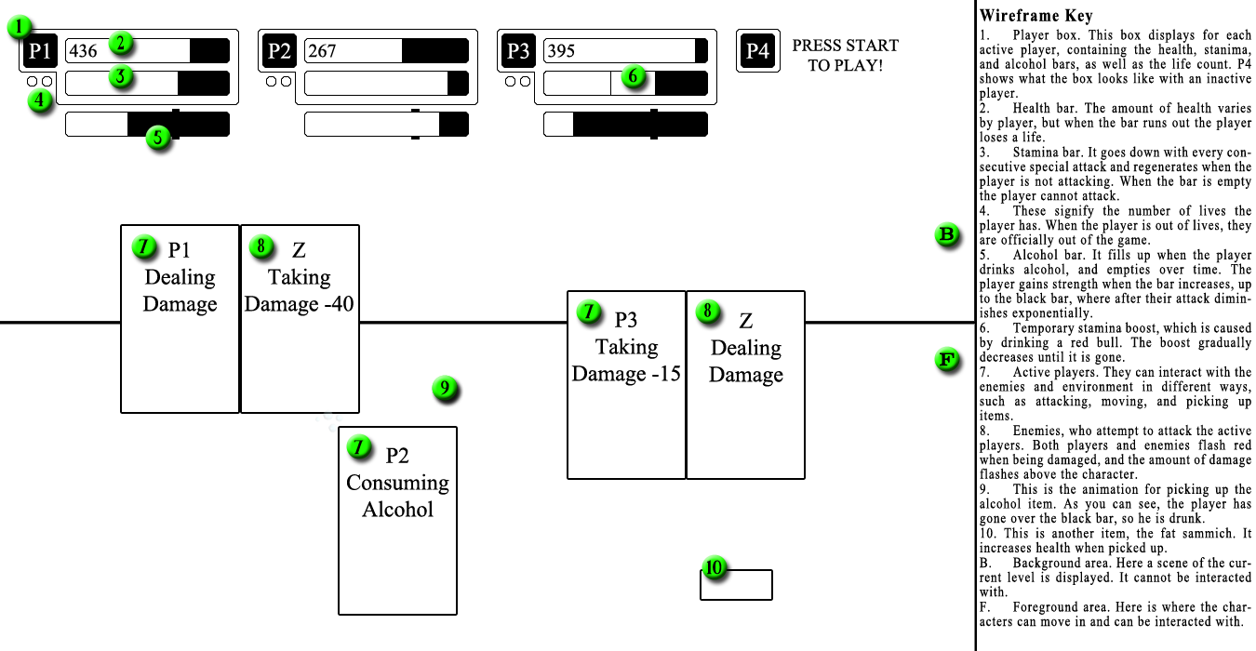

Slide 14
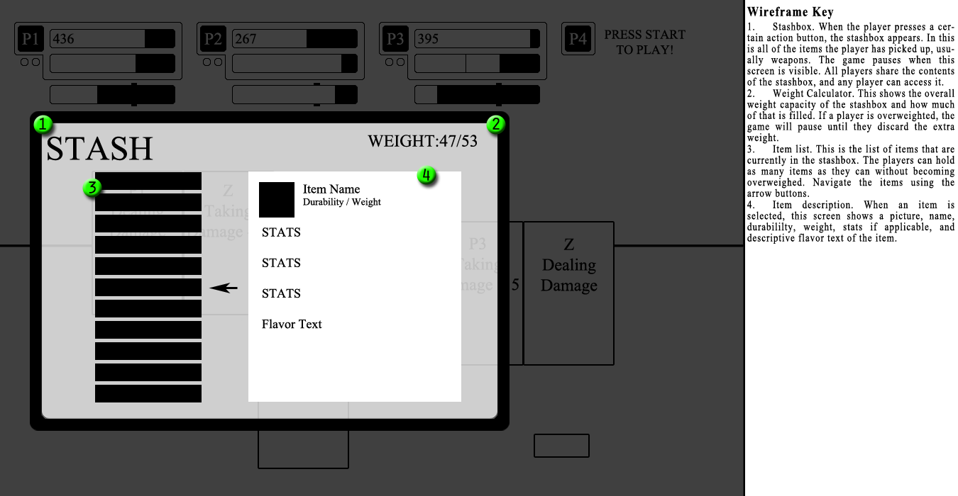

Slide 15
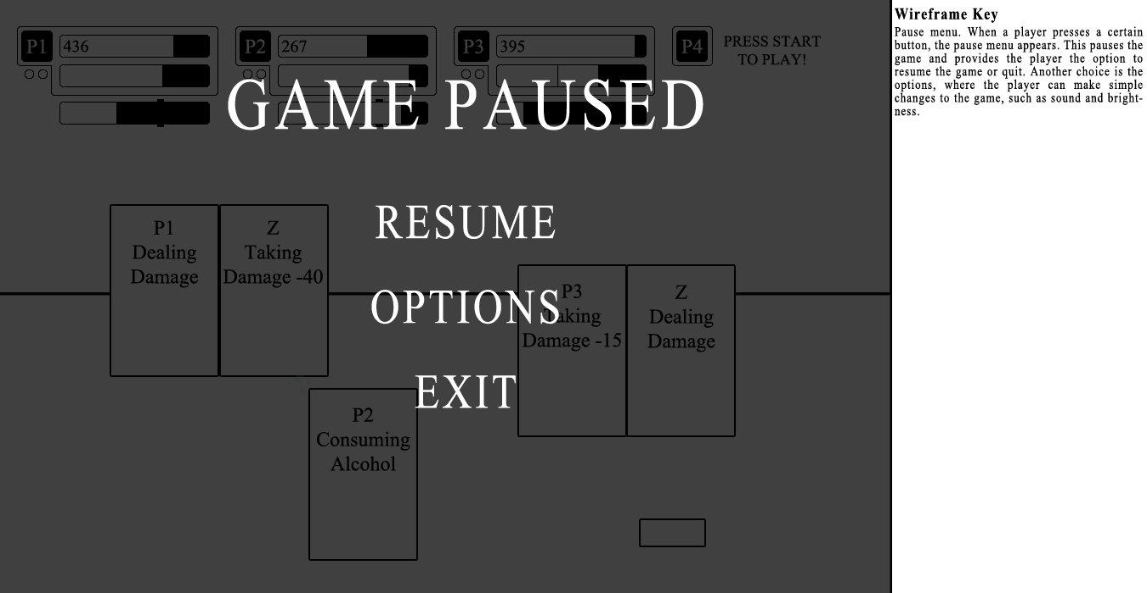

Slide 16
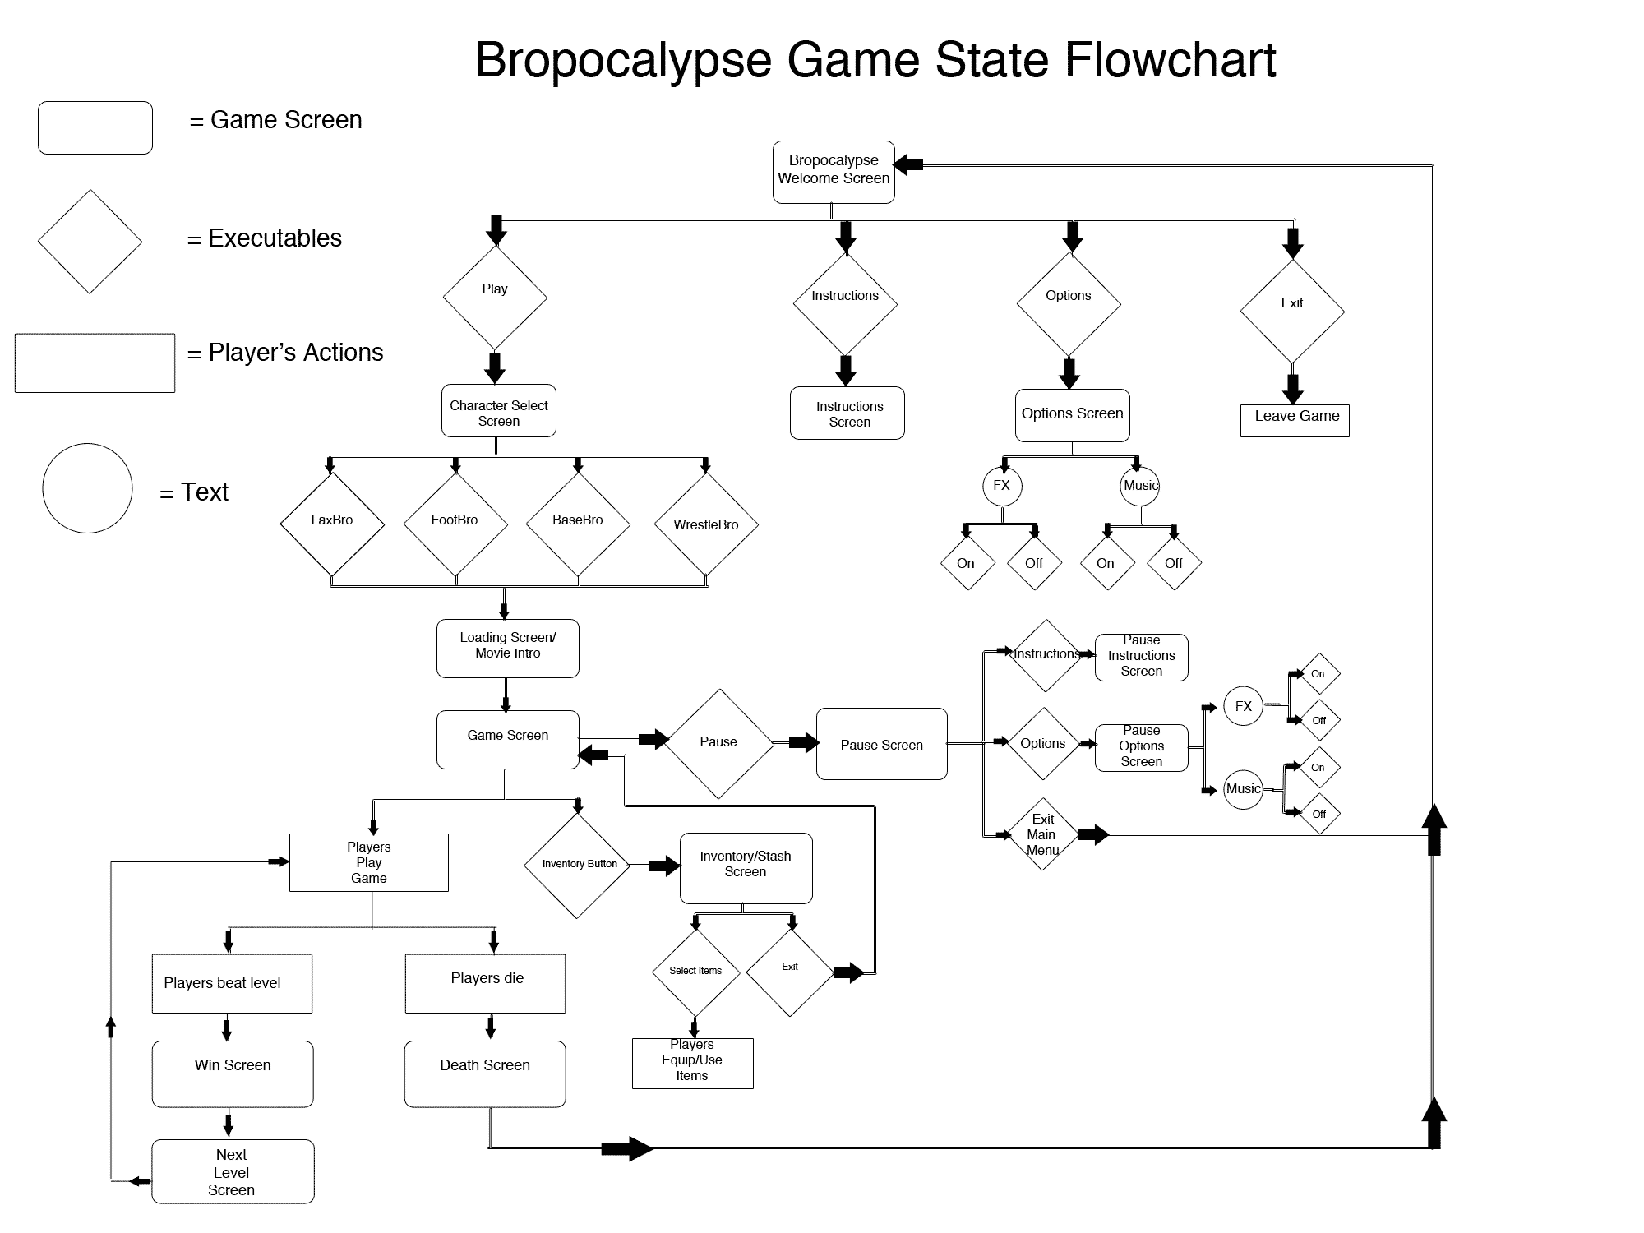

Slide 17


Slide 18


Suddenly…
HEY BRAH, YOU SHOULD TOTALLY CHECK OUT UNITY. IT’S WAY BETTER THAN WHATEVER YOU’RE DOING.

Slide 19


New Concept
Still a side-scroller, except now in 3D instead of 2D, ala “Turtles in Time”
Art style transfers from 32-bit to 3D models
Program changes
Photoshop -> Maya for art
Processing -> Unity for coding & game structure

Slide 20
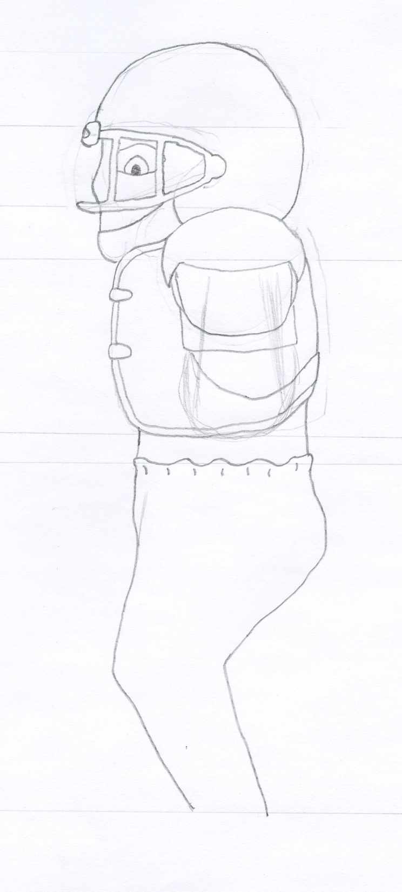
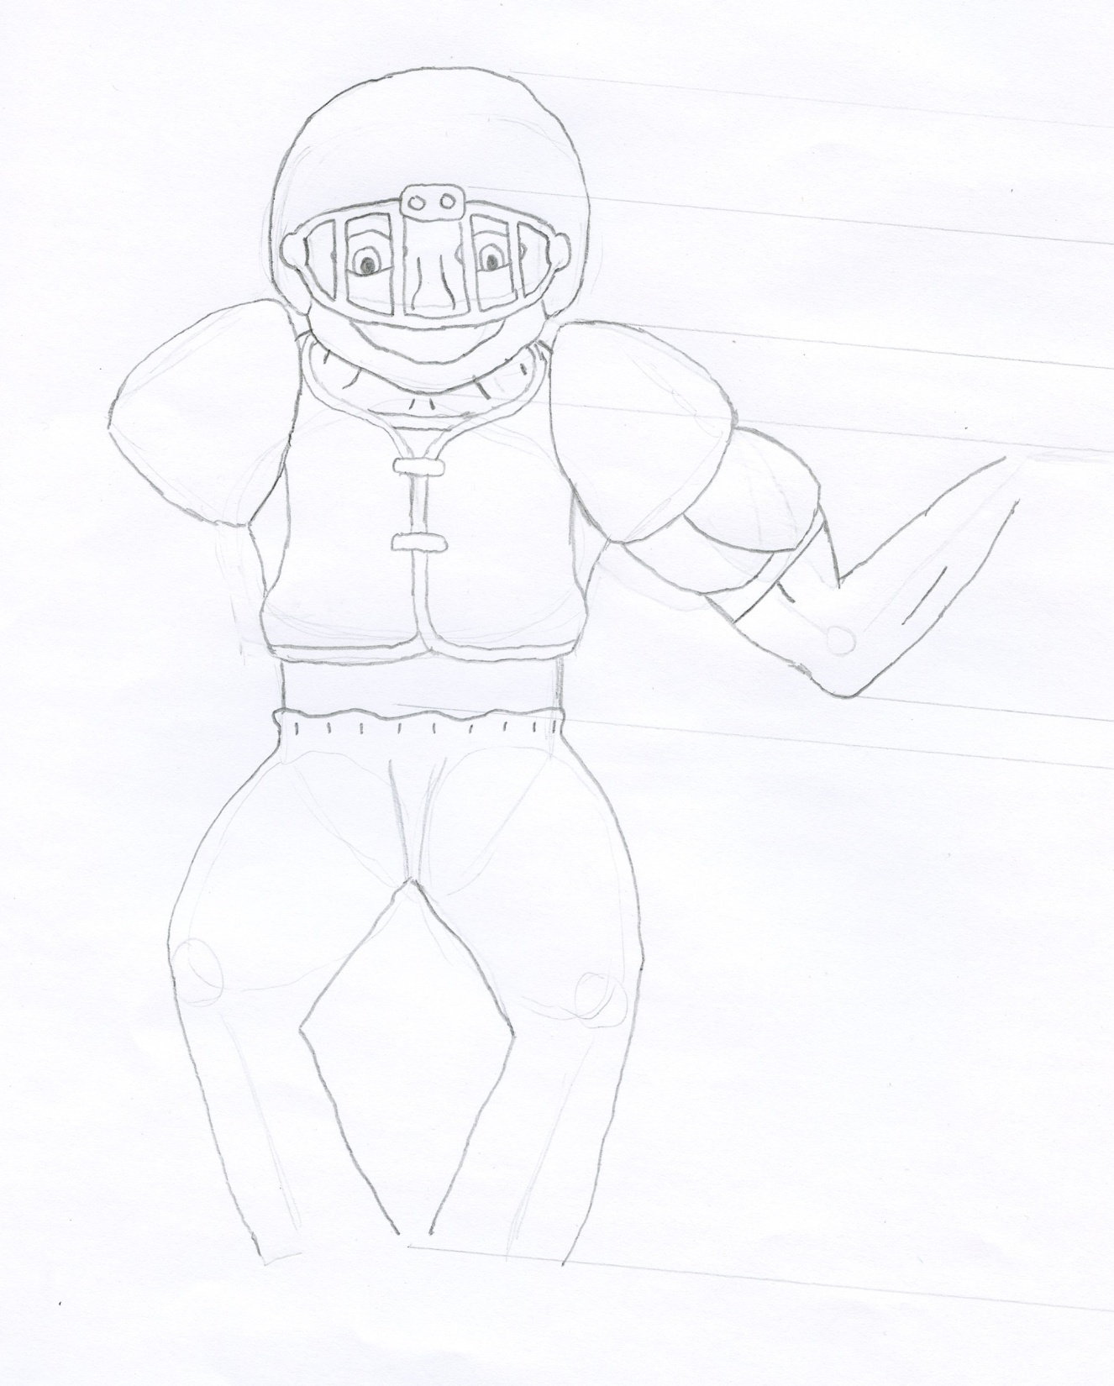

Slide 21
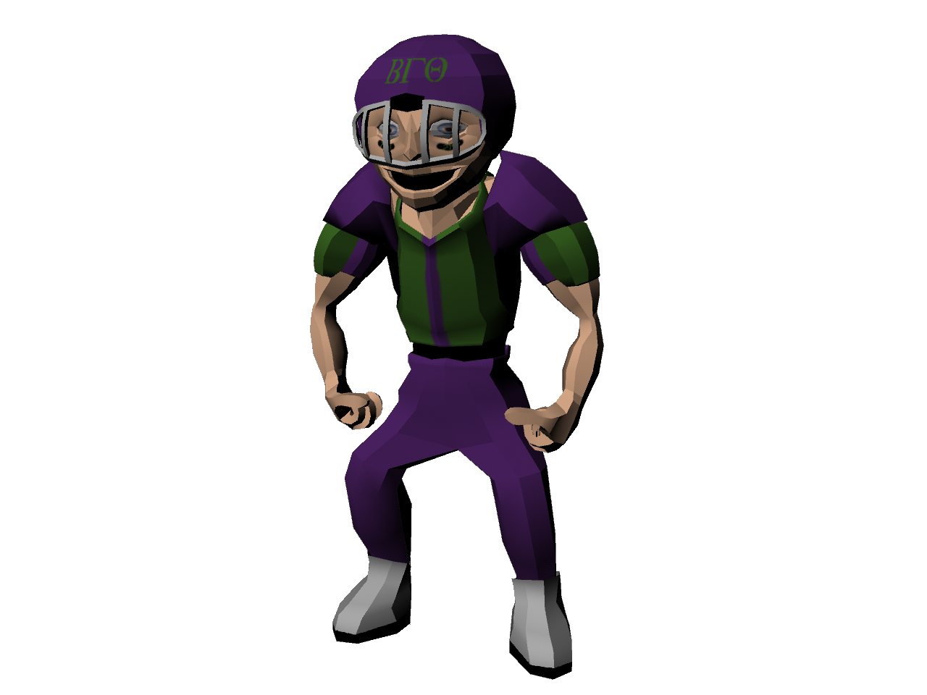

Slide 22
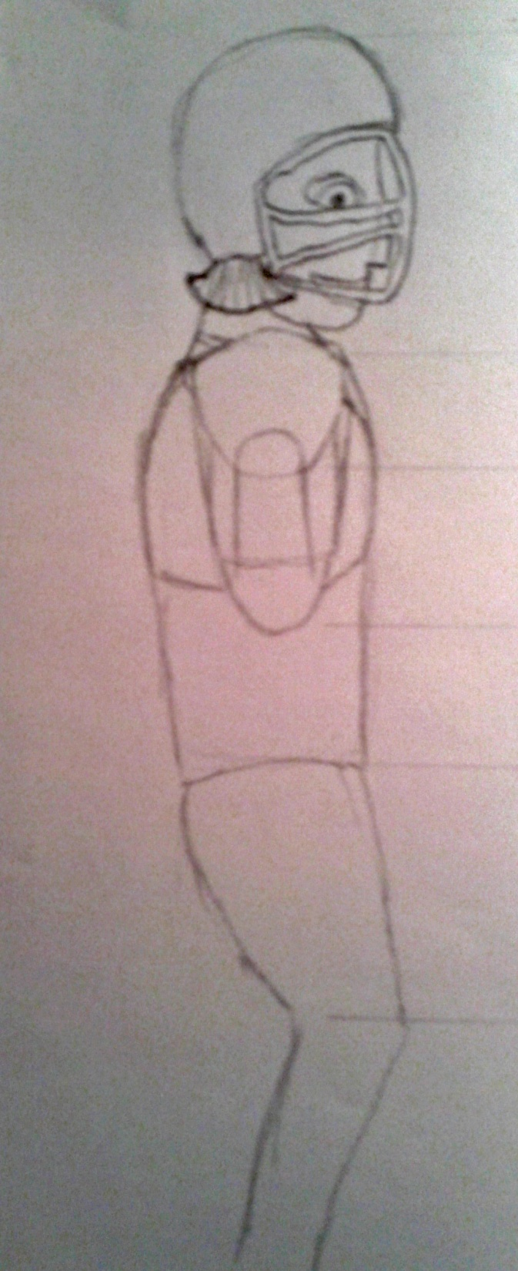
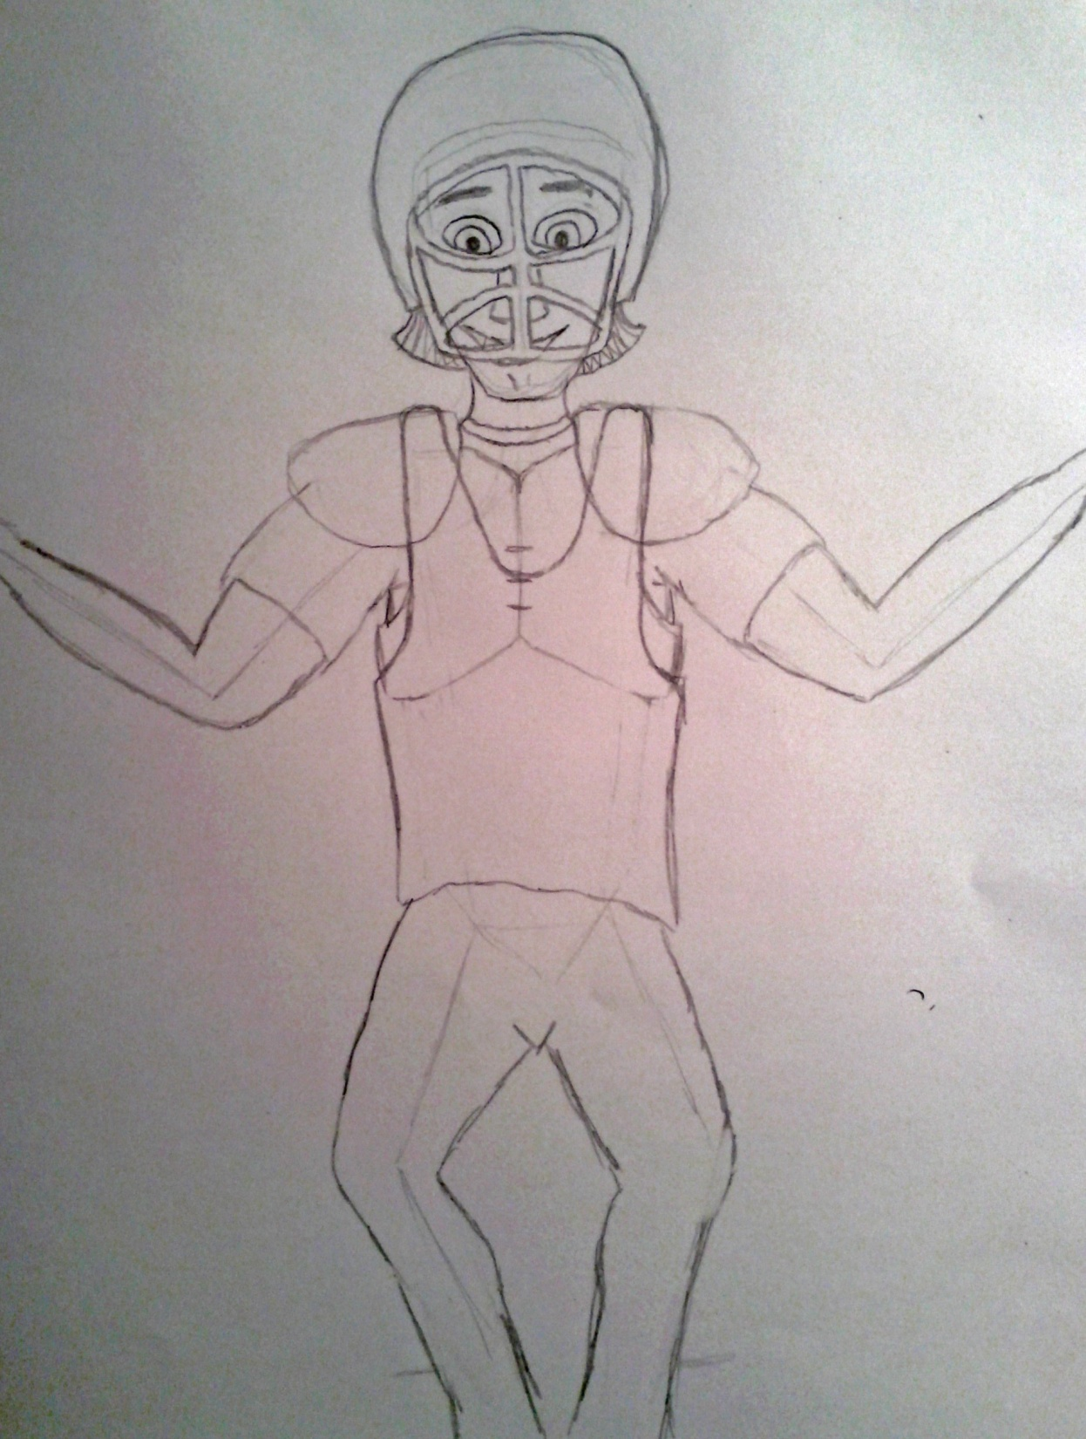

Slide 23
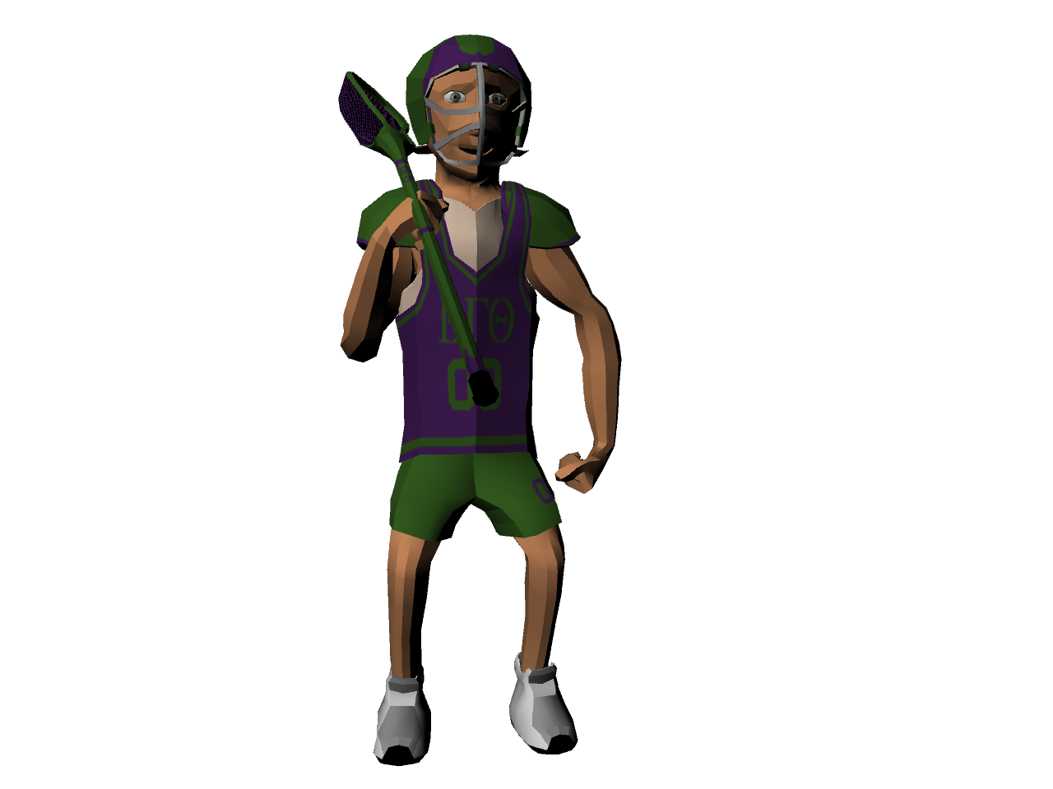

Slide 24
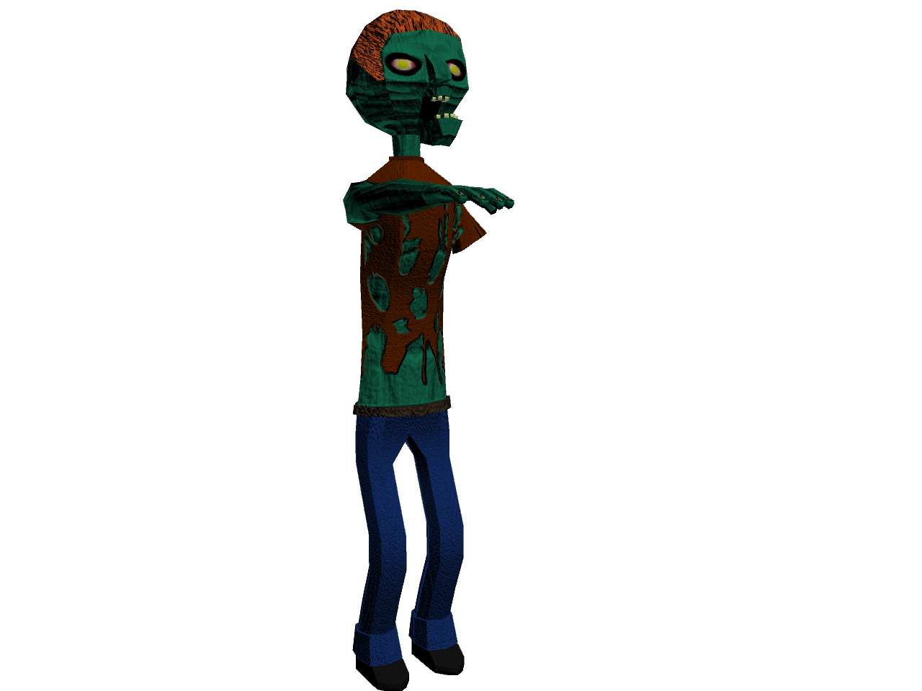

Slide 25
